Slide 1

Working with Abstraction
Architecture, Refactoring and Enumerations
SoftUni Team
Technical Trainers
Software University
http://softuni.bg

Slide 2
Table of Contents
Project Architecture
Methods
Classes
Projects
Code Refactoring
Enumerations

Slide 3
Questions
sli.do #fund-csharp

Slide 4

Project Architecture
Splitting Code into Logical Parts

Slide 5
Splitting Code into Methods
We use methods to split code into functional blocks
Improves code readability
Allows for easier debugging
foreach (char move in moves)
{
for (int r = 0; r < room.Length; r++)
for (int c = 0; c < room[r].Length; c++)
if (room[row][col] == 'b')
…
}
foreach (char m in moves)
{
MoveEnemies();
KillerCheck();
MovePlayer(move);
}

Slide 6
Splitting Code into Methods (2)
Methods let us easily reuse code
We change the method once to affect all calls
var bankAcc = new BankAccount();
bankAcc.Id = 1;
bankAcc.Deposit(20);
Console.WriteLine($"Account {bankAcc.Id}, balance {bankAcc.Balance}");
bankAcc.Withdraw(10);
…
Console.WriteLine($"Account {bankAcc.Id}, balance {bankAcc.Balance}");
Override .ToString() to set a global printing format
Console.WriteLine(bankAcc.ToString());

Slide 7

Splitting Code into Methods (3)
A single method should complete a single task
void DoMagic ( … )
void DepositOrWithdraw ( … )
decimal DepositAndGetBalance ( … )
string ParseDataAndReturnResult ( … )
void Withdraw ( … )
void Deposit ( … )
decimal GetBalance ( … )
string ToString ( … )

Slide 8
Problem: Rhombus of Stars
Draw on the console a rhombus of stars with size n
n = 3
n = 2
n = 1
*
* *
* * *
* *
*
*
* *
*
*
Check your solution here: https://judge.softuni.bg/Contests/955/Working-with-Abstraction-Lab

Slide 9
Solution: Rhombus of Stars
int size = int.Parse(Console.ReadLine());
for (int starCount = 1; starCount <= size; starCount++)
{
PrintRow(size, starCount);
}
for (int starCount = size - 1; starCount >= 1; starCount--)
{
PrintRow(size, starCount);
}
Reusing code
Check your solution here: https://judge.softuni.bg/Contests/955/Working-with-Abstraction-Lab

Slide 10
Solution: Rhombus of Stars(2)
static void PrintRow(int figureSize, int starCount)
{
for (int i = 0; i < figureSize - starCount; i++)
Console.Write(" ");
for (int col = 1; col < starCount; col++)
Console.Write("* ");
Console.WriteLine("*");
}
Check your solution here: https://judge.softuni.bg/Contests/955/Working-with-Abstraction-Lab

Slide 11
Splitting Code into Classes
Just like methods, classes should not know or do too much
GodMode master = new GodMode();
int[] numbers = master.ParseAny(args);
...
int[] numbers2 = master.CopyAny(numbers);
master.PrintToConsole(master.GetDate());
master.PrintToConsole(numbers);

Slide 12
Splitting Code into Classes (2)
We can also break our code up logically into classes
int[] numbers = args.Split().Select(int.Parse).ToArray();
. . .
Console.Write(string.Join(" ", numbers));
Hiding implementation
ArrayParser parser = new ArrayParser();
OuputWriter printer = new OuputWriter();
int[] numbers = parser.IntegersParse(args);
int[] coordinates = parser.IntegerParse(args1);
printer.PrintToConsole(numbers);
Allow us to change output destination
Helps us avoid repeating code

Slide 13
Problem: Point in Rectangle
Create a Point class holding the horizontal and vertical coordinates
Create a Rectangle class
Holds 2 points
Top left and bottom right
Add Contains method
Takes a Point as an argument
Rturns it if it’s inside the current object of the Rectangle class
Check your solution here: https://judge.softuni.bg/Contests/955/Working-with-Abstraction-Lab

Slide 14
Solution: Point in Rectangle
public class Point
{
private int x;
private int y;
//TODO: Add Public properties
}
public class Rectangle
{
private Point topLeft;
private Point bottomRight;
//TODO: Public properties
public bool Contains(Point point)
{ //TODO: Implement }
}
Check your solution here: https://judge.softuni.bg/Contests/955/Working-with-Abstraction-Lab

Slide 15
Solution: Point in Rectangle (2)
public bool Contains(Point point)
{
bool isInHorizontal = this.TopLeft.X <= point.X && this.BottomRight.X >= point.X;
bool isInVertical = this.TopLeft.Y <= point.Y && this.BottomRight.Y >= point.Y;
bool isInRectangle = isInHorizontal && isInVertical
return isInRectangle;
}
Check your solution here: https://judge.softuni.bg/Contests/955/Working-with-Abstraction-Lab

Slide 16

Refactoring
Restructuring and Organizing Code

Slide 17
Refactoring
Restructures code without changing the behaviour
Improves code readability
Reduces complexity
class ProblemSolver { public static void DoMagic() { … } }
class CommandParser { public static Func<T, T> ParseCommand(); }
class DataModifier { public static T Execute(); … }
class OutputFormatter { public static void Print(); … }

Slide 18
Refactoring Techniques
Breaking code into reusable units
Extracting parts of methods and classes into new ones
Deposit()
Withdraw()
DepositOrWithdraw()
Improving names of variables, methods, classes, etc.
string str;
string name;
Moving methods or fields to more appropriate classes
Car.Open()
Door.Open()

Slide 19
Problem: Student System
You are given a working Student System project to refactor
Break it up into smaller functional units and make sure it works
It supports the following commands:
"Create <studentName> <studentAge> <studentGrade>"
creates a new student
"Show <studentName>"
prints information about a student
"Exit"
closes the program
Check your solution here: https://judge.softuni.bg/Contests/955/Working-with-Abstraction-Lab

Slide 20
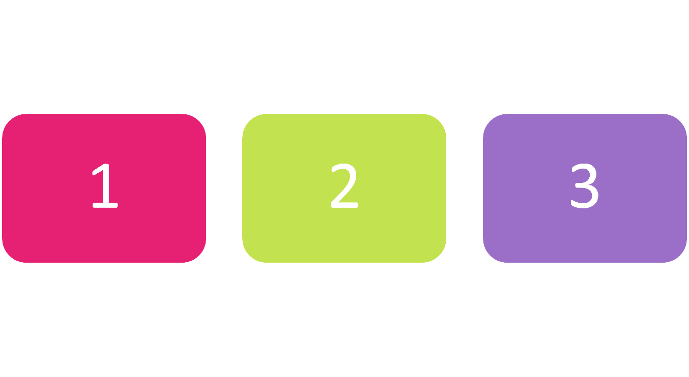
Enumerations
Syntax and Usage

Slide 21
Enumerations
Represent a numeric value from a fixed set as a text
We can use them to pass arguments to methods without making code confusing
By default enums start at 0
Every next value is incremented by 1
enum Day { Mon, Tue, Wed, Thu, Fri, Sat, Sun }
GetDailySchedule(0)
GetDailySchedule(Day.Mon)

Slide 22




Enumerations (2)
We can customize enum values
enum Day
{
Mon = 1,
Tue, //2
Wed, //3
Thu, //4
Fri, //5
Sat, //6
Sun //7
}
enum CoffeeSize
{
Small = 100,
Normal = 150,
Double = 300
}

Slide 23

Problem: Hotel Reservation
Create a class PriceCalculator that calculates the total price of a holiday, by given price per day, number of days, the season and a discount type
The discount type and season should be enums
The price multipliers will be:
1x for Autumn, 2x for Spring, etc.
The discount types will be:
None – 0%
SecondVisit – 10%
VIP – 20%
Check your solution here: https://judge.softuni.bg/Contests/955/Working-with-Abstraction-Lab

Slide 24
Solution: Hotel Reservation
public enum Season
{
Spring = 2,
Summer = 4,
Autumn = 1,
Winter = 3
}
public enum Discount
{
None,
SecondVisit = 10,
VIP = 20
}
Check your solution here: https://judge.softuni.bg/Contests/955/Working-with-Abstraction-Lab

Slide 25
Solution: Hotel Reservation (2)
public class PriceCalculator
{
public static decimal CalculatePrice(decimal pricePerDay, int numberOfDays, Season season, Discount discount)
{
int multiplier = (int)season;
decimal discountMultiplier = (decimal)discount / 100;
decimal priceBeforeDiscount = numberOfDays * pricePerDay * multiplier;
decimal discountedAmount = priceBeforeDiscount * discountMultiplier;
decimal finalPrice = priceBeforeDiscount - discountedAmount;
return finalPrice;
}
}
Check your solution here: https://judge.softuni.bg/Contests/955/Working-with-Abstraction-Lab

Slide 26

Summary
…
…
…
Well organized code is easier to work with
We can reduce complexity using Methods, Classes and Projects
We can refactor existing code by breaking code apart
Enumerations define a fixed set of constants
Represent numeric values
We can easily cast enums to numeric types

Slide 27













SoftUni Diamond Partners

Slide 28





SoftUni Organizational Partners

Slide 29




Trainings @ Software University (SoftUni)
Software University – High-Quality Education and Employment Opportunities
softuni.bg
Software University Foundation
http://softuni.foundation/
Software University @ Facebook
facebook.com/SoftwareUniversity
Software University Forums
forum.softuni.bg

Slide 30

License
This course (slides, examples, demos, videos, homework, etc.) is licensed under the "Creative Commons Attribution-NonCommercial-ShareAlike 4.0 International" license

